Slide 1
Data Structures

Slide 2
Agenda
Root to Leaf Path Sum
All Paths from root with a specified sum
Max Path Sum
Diameter of a Binary Tree

Slide 3
Root to Leaf Path Sum
Link: https://practice.geeksforgeeks.org/problems/root-to-leaf-path-sum/1/

Slide 4
All Paths from root with a specified sum
Link: https://practice.geeksforgeeks.org/problems/paths-from-root-with-a-specified-sum/1/

Slide 5
Max Path Sum
Link: https://practice.geeksforgeeks.org/problems/maximum-path-sum-from-any-node/1/

Slide 6
Max Path Sum

Slide 7
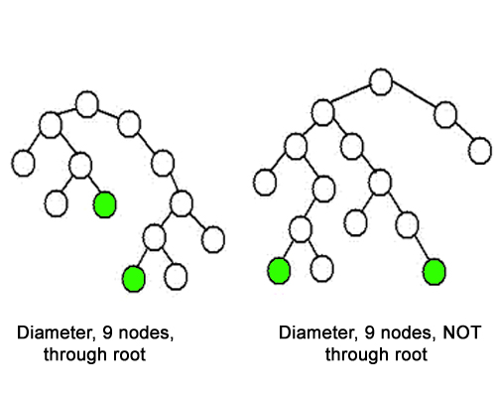
Diameter of a Binary Tree
Link: https://practice.geeksforgeeks.org/problems/diameter-of-binary-tree/1/

Slide 8
Diameter of a Binary Tree
Link: https://practice.geeksforgeeks.org/problems/diameter-of-binary-tree/1/

Slide 9
THANK YOU

